Slide 1
Additional Visualizations

Slide 2
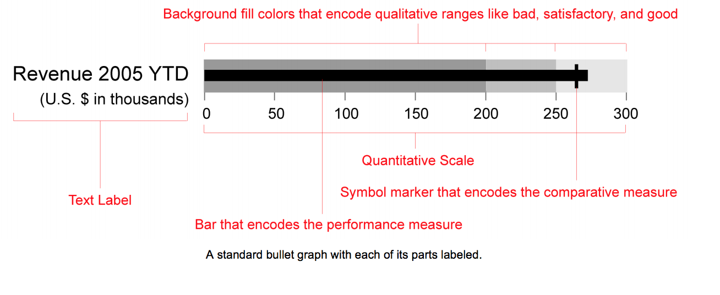
Bullet Graph
Source: https://www.perceptualedge.com/articles/misc/Bullet_Graph_Design_Spec.pdf
https://datavizcatalogue.com/methods/bullet_graph.html

Slide 3
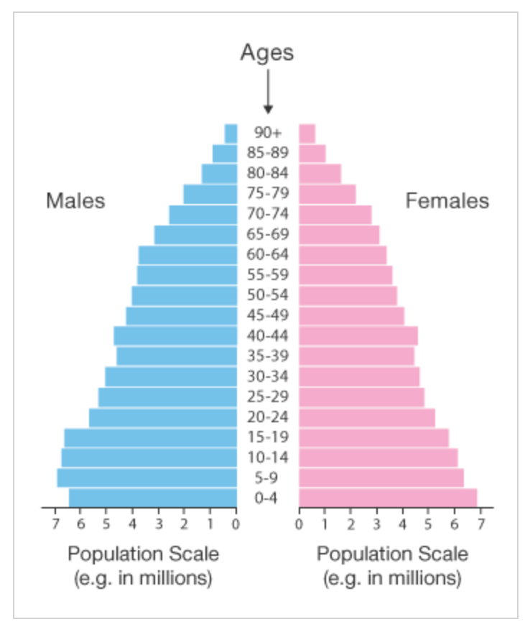
Pyramid Graph
Source: https://datavizcatalogue.com/methods/population_pyramid.html

Slide 4
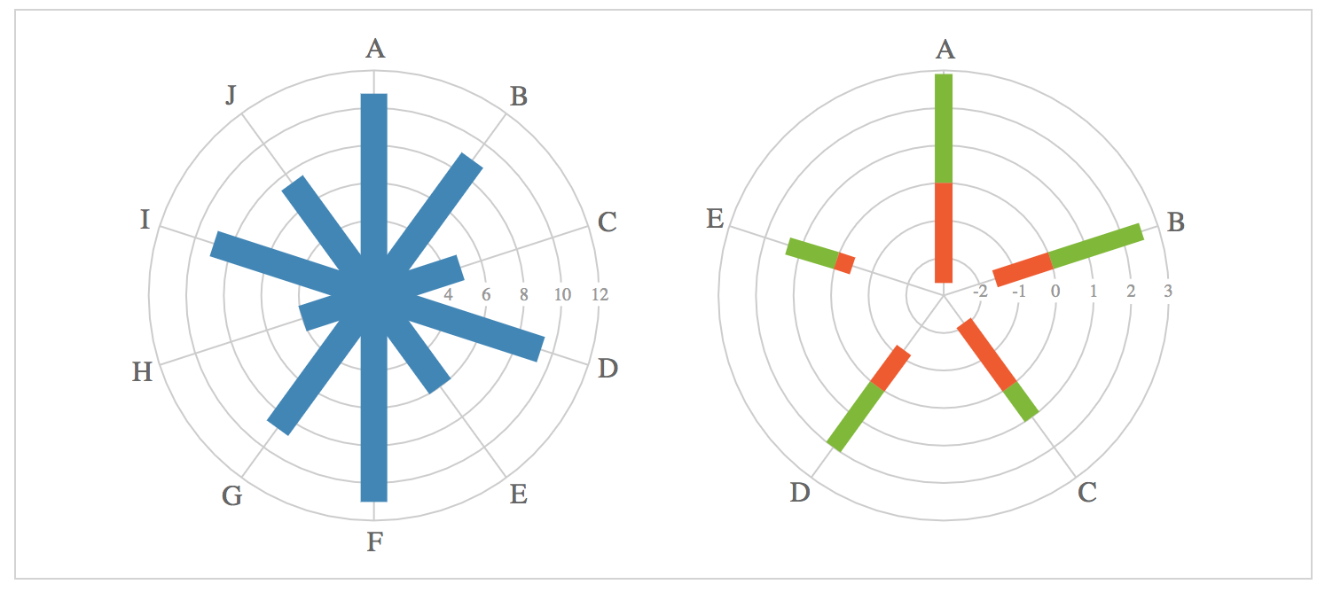
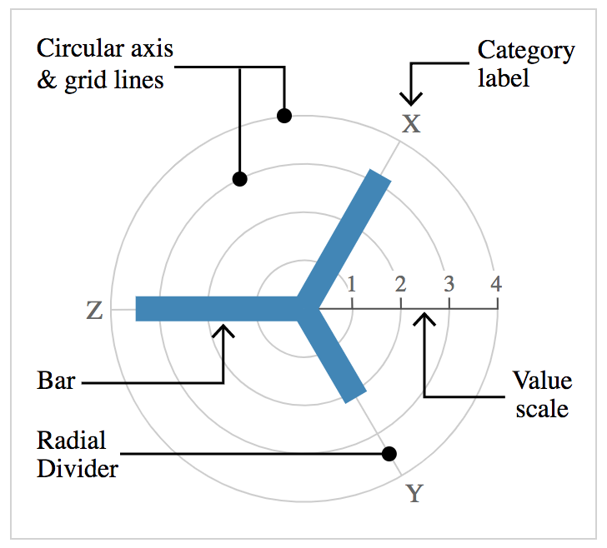
Radial Column Chart (Circular Colum Chart)
Source: https://datavizcatalogue.com/methods/radial_column_chart.html

Slide 5
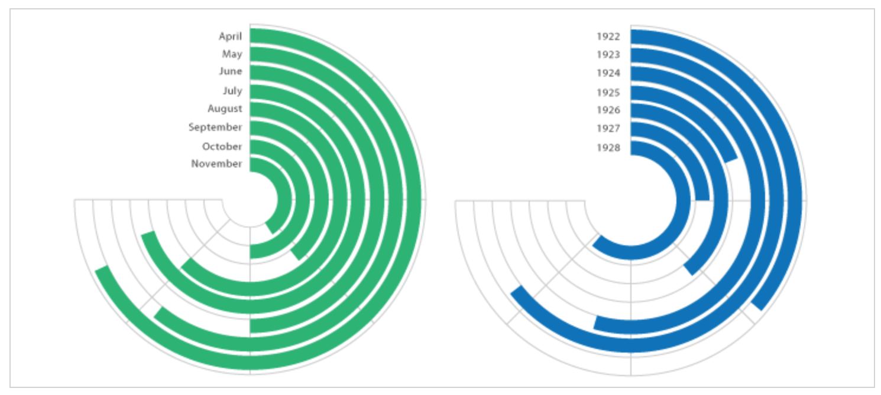
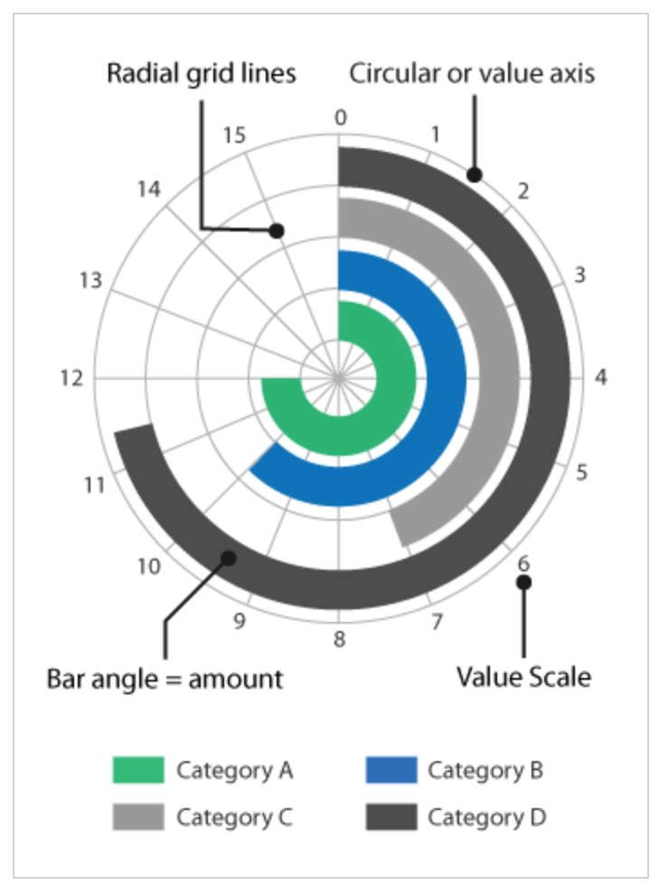
Radial Bar Chart (Circular Bar Chart)
Source: https://datavizcatalogue.com/methods/radial_bar_chart.html

Slide 6
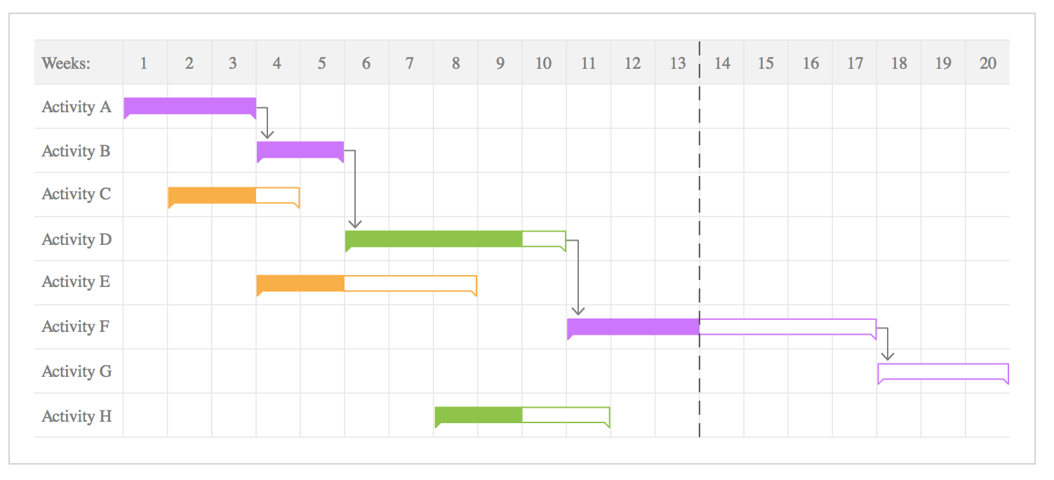
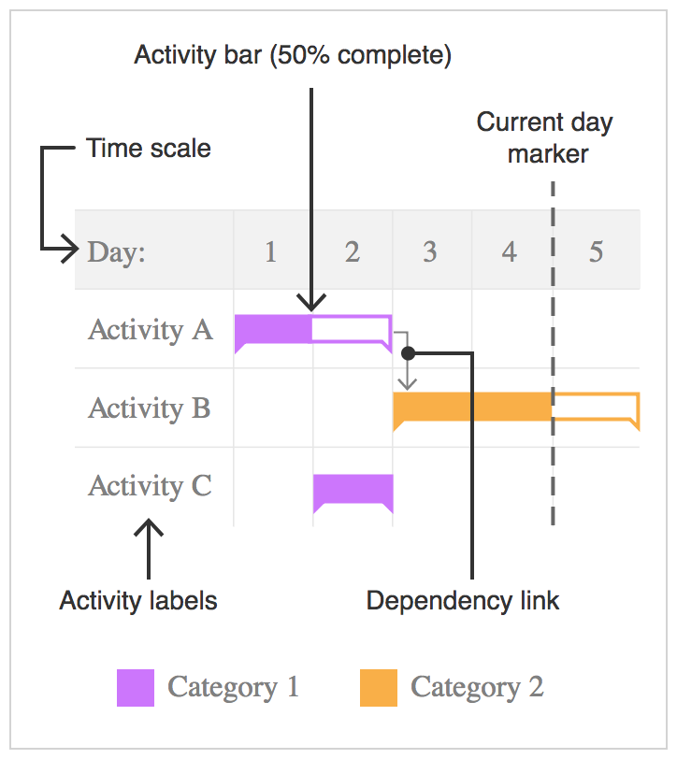
Gantt Chart
Source: https://datavizcatalogue.com/methods/gantt_chart.html

Slide 7
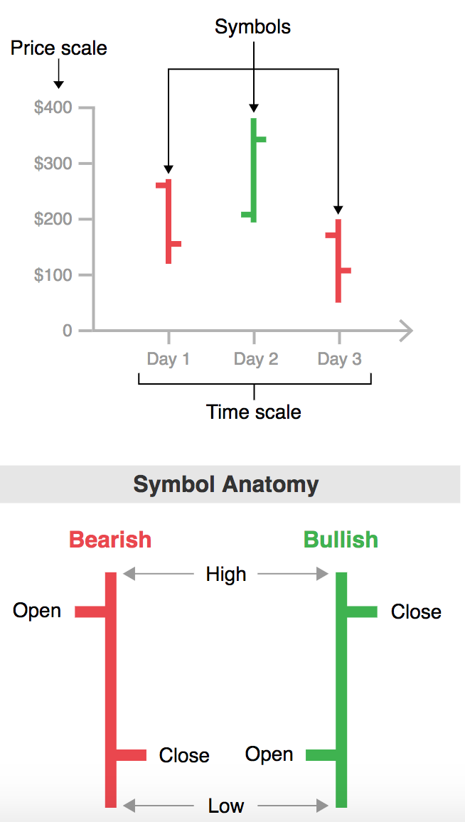
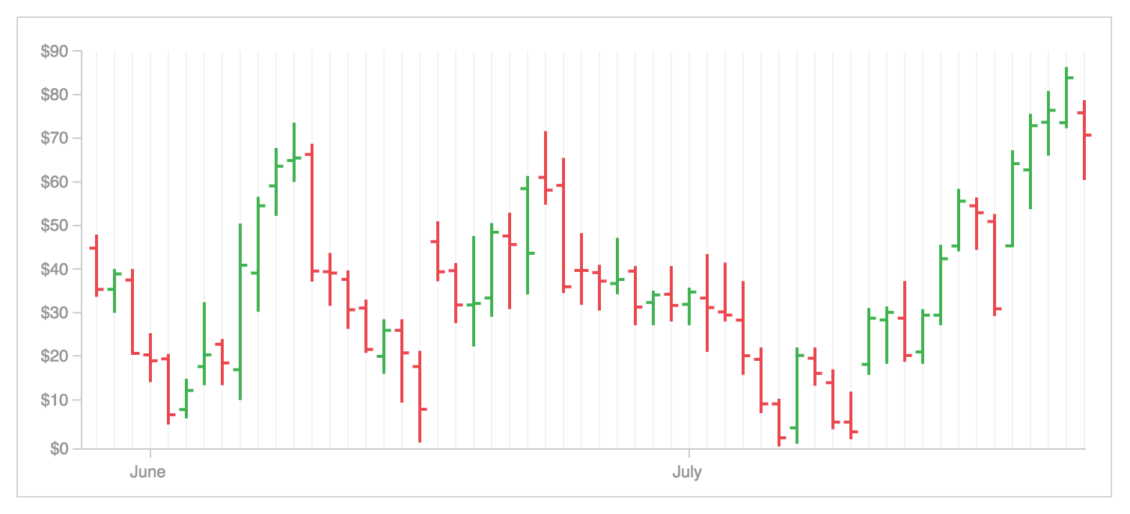
Open-high-low-close Chart
Source: https://datavizcatalogue.com/methods/OHLC_chart.html

Slide 8
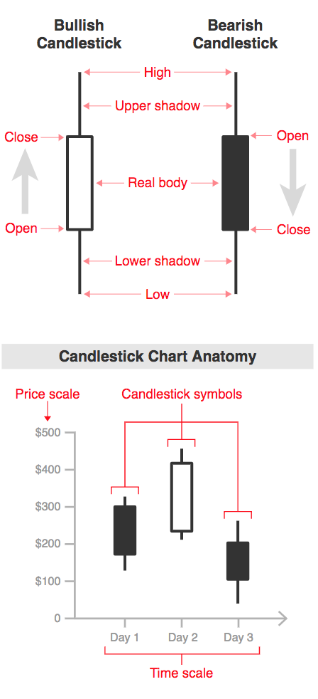
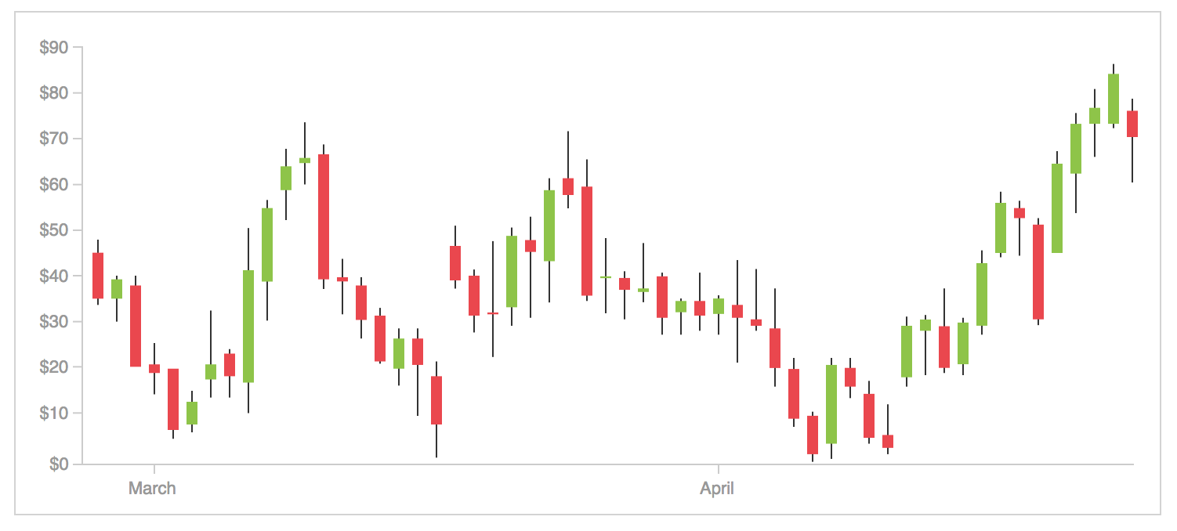
Candlestick Chart
Source: https://datavizcatalogue.com/methods/candlestick_chart.html
https://en.wikipedia.org/wiki/Candlestick_pattern

Slide 9
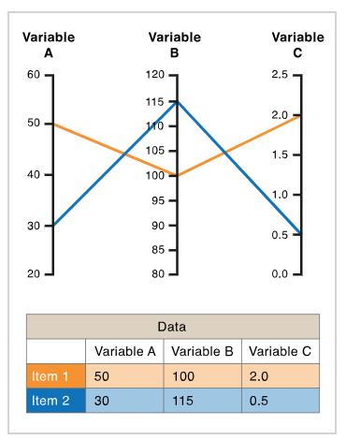
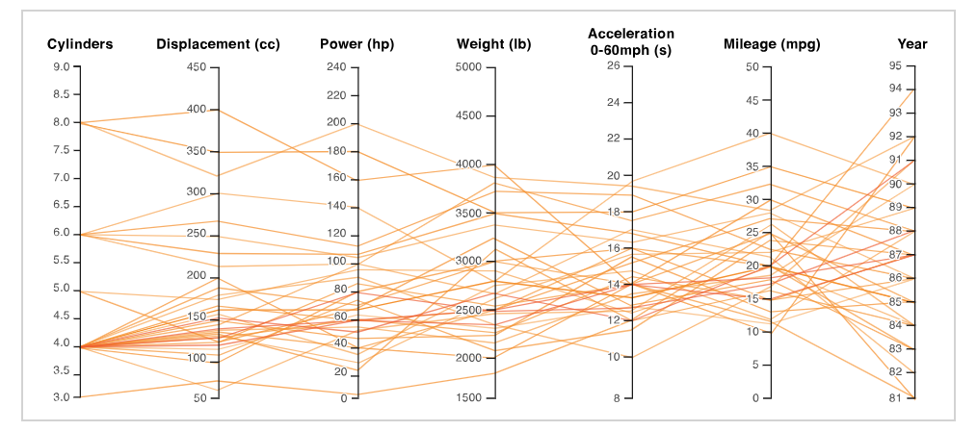
Parallel Coordinates Plot
Source: https://datavizcatalogue.com/methods/parallel_coordinates.html

Slide 10
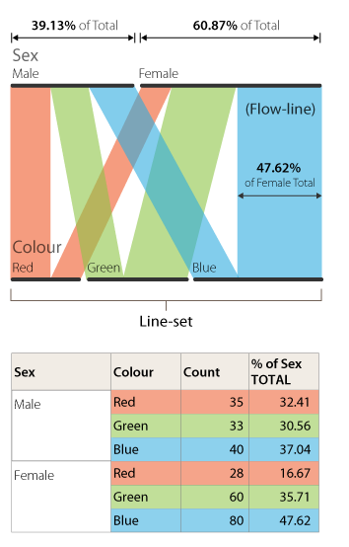
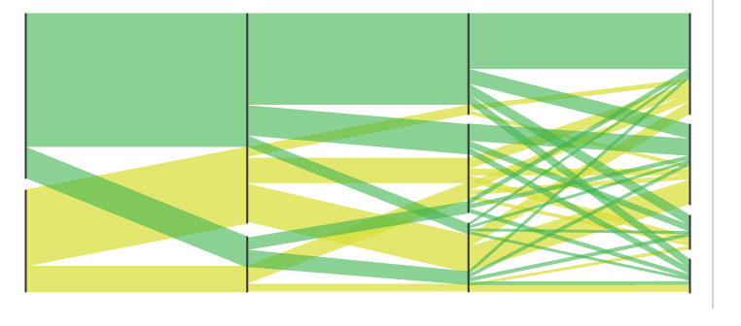
Parallel Set Plot/ Alluvial Diagrams
Source: https://datavizcatalogue.com/methods/parallel_sets.html

